Slide 1


Churchwarden Training 20th January 2022
Faculty Application Basics
Presented by the Church Buildings Team
Notes:
Hello and welcome to this short presentation on faculty application basics. My name is Daniel Crooke and I am the DAC secretary, part of the Church Buildings Team. Today we are just going to spend a few minutes going through the basics of a faculty application and the key information you will need.

Slide 2
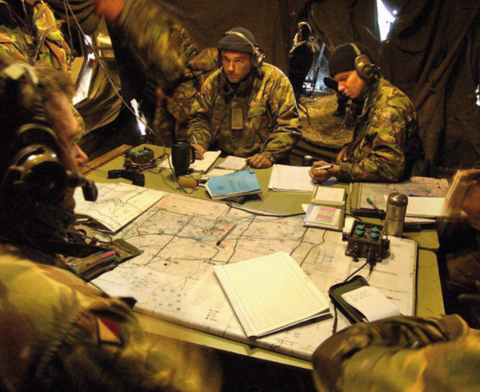
Preliminaries
Total of 3o minutes long
Mute microphones
Questions
Notes
Slides with links will be on the DAC website in the ‘Resources Library’
Notes:
The presentation is going to be around 30 min long with some time added at the end for any questions.
Please mute microphones when not speaking. Happy to take questions as we go along so do raise your hand or pop it into the chat.
Feel free to take notes but we will be making the slides and links available so you can refer back if you need to.

Slide 3

Scope
Who’s who
Pre-application
Permissions
Application paperwork
Notes:
So the things we are going to cover are, who are the main people involved in the faculty system
Some guidance on what to do and where to go if you have some initial thoughts for a project
What permissions you might need and where to go to check.
And finally a section on the standard documents required for an application and where to find them.

Slide 4
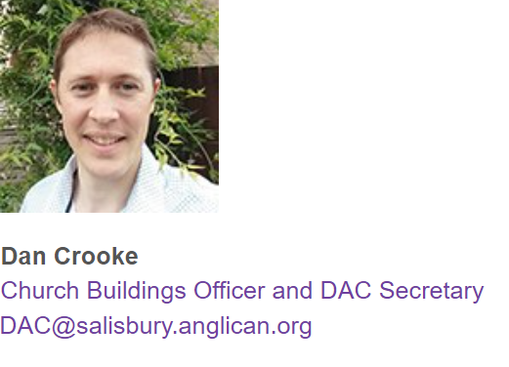
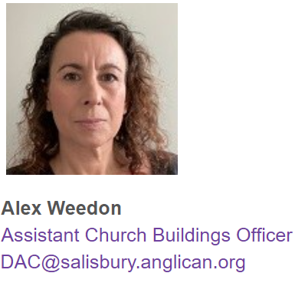
Who’s who
Nb. Working hours are Mon – Thurs 0900-1400
Website: https://www.salisbury.anglican.org/parishes/dac
Notes:
The Church Buildings Team currently consists of myself and Alex with recruitment for a new member starting soon.
We cover nearly all aspects of the faculty system and the managing of the DAC committee. We help applicants with all aspects of the faculty process from initial thoughts right through to developing and finishing a faculty application.
We are the first port of call for any questions you may have concerning church buildings or churchyards. We also have the DAC website where you will be able to find plenty of useful information which we will be adding to as things get produced.
Because there are only two of us in the team at the moment it does take us a little time to get to enquiries. We have approximately a 5 working day response time so please do factor this in when contacting us.

Slide 5
Who’s who
Practical review of application
Legal review of application
DAC committee
Amenity Societies
Archdeacons
Chancellor of the Diocese
Organisations with a specialist interest who must be consulted during faculty applications for various works, these include:
Victorian Society
Historic England
Society for the Protection of Ancient Buildings (SPAB)
Georgian Group
20th Century Society
Church Buildings Council
Chancellor delegates power to grant List B permission
Archdeacon of Sarum –
The Venerable Alan Jeans
Archdeacon of Sherborne –
The Venerable Penny Sayer
Archdeacon of Wilts –
The Venerable Sue Groom
Archdeacon of Dorset –
The Venerable Antony MacRow-Wood
A group of volunteers with specialisms relating
to church buildings who advise the Chancellor on faculty applications and who are appointed by Bishop’s Council
Chair – The Revd Richard Curtis
The Judge of the consistory court of the dioceses. The Chancellor is the sole decision maker for all faculty matters.
Mrs Ruth Arlow
Contact: The Diocesan Registry
Diocesan Registry
The legal office of the Diocese, employed at the law firm Batt Broadbent. The team ensure that the application forms are accurate and due legal process has been followed.
Registrar - Sue de Candole
Deputy Registrar – Rachel Wilson
Registry Clerk – Alix Austen
Registry Clerk – Sarah Hart
Registry Clerk – Anita Jeans
Church Buildings Team
The Secretariat for the DAC Committee.
The team at Church House are the first point of contact for all
faculty and List B matters.
Mr Daniel Crooke – DAC Secretary
Mrs Alex Weedon – Assistant Church Building Officer
Applicant/Petitioner
A representative of a PCC or private individual
wishing to apply (petition) for permission to carry out works within the church or churchyard
Notes:
This slide details the key personalities involved in the faculty process. There is a lot of information here and I am not going to go through it all now but the key takeaway is that the Church Buildings Team deal with many individuals and organisations involved in the faculty process. Even if we cannot answer your question directly it is likely that we will be able to point you in the right direction.
You will be able to find this presentation on the DAC website in the Resource Library and a link to this can be found on the last slide.

Slide 6
Pre-application
Basic Flow Diagram
Initial thoughts
Basic research
Early advice from DAC/CBT
Pre-formal Advice
Application compilation
Site visit (for larger complex projects)
Finalise application
Formal advice/consultation
Submission to Chancellor
Grant of faculty
Notes:
We’re just going to quickly go through a very basic flow diagram of a faculty application from start to finish. On the DAC website we have a more in –depth version for those interested.
Once you have had your initial thought and done some basic research it is time to seek early advice. By this time you should have a basic knowledge of things and have some more specific questions.
It may be that, for larger more complex projects a site visit would be beneficial.
Once receiving some initial advice you should have enough to compile a basic application. Depending on the project at this stage it may not be any more than just preliminary design work.
With that we can seek pre-formal advice. This is to help focus and narrow the application and help you to understand where the potential contention will be.
Armed with the advice you can finalise your application. That is detailed drawings specifications etc.
We then do a formal round of advice, which can take up to 42 days.
Assuming all the advice is good and positive the application goes to the Chancellor for decision and all being well the faculty is granted.

Slide 7
Pre-application
Initial stage
Check the latest guidance
Church Buildings Council
Historic England
Church Buildings Team
Find out what permission may be needed
Schedule 1 of the Faculty Jurisdiction Rules 2019 covers List A and B matters
If in doubt speak to the Church Buildings Team
Understand the need and significance
Start to fill out the template statement of significance and need.
Understand the significance.
Establish the need.
Seek early advice
DAC
Statutory Amenity Societies
Local Planning Authority
Notes:
If you have an idea the first step would be to seek relevant guidance. There are a myriad of websites out there offering advice, which can be confusing and I am not recommending a deep dive at the early stage but to get a flavour of whether your ideas would be positively received.
We would recommend the Church Buildings Council website as a first start. There is a lot of accessible church related guidance and this is what the DAC adheres to.
The second is Historic England who have a large volume of guidance notes. Whilst aimed largely at secular buildings conservation principles will still apply so will be relevant for certain proposals.
The third is to contact the Church Buildings Team. It may be that we have seen similar proposals before and will be able to highlight any common pitfalls or aspects that you will want to look at. We may recommend other parishes to speak to or look to set up a DAC site visit.
It is important to have an early idea of what permission is required. This will likely effect the approach that is taken. Schedule 1 covers all List A and B matters. If in doubt speak to the Church Buildings Team. Works undertaken without the appropriate permission is illegal.
If a faculty is required it is important to have an understanding of the need and significance. Start to fill out the standard templates of the statement of significance and need. Guidance on this can be found on the CBC website and the Church Buildings Team can also give guidance on key points to think about.
Understanding the significance of the building will help guide your ideas. For listed buildings Historic England keeps a record of key features and why it is listed. A link can be found at the end.
In some circumstances the need can be obvious but it is important to state this anyway. For larger reordering schemes that are looking to provide facilities it is important to prove the need of the wider community and as such consultation and engagement may be needed.
Always seek early advice. This can be the DAC, Statutory Amenity Societies or the Local Planning Authority it is likely it could be all of them.

Slide 8
Permissions
Other Permissions**
Interim Faculty (investigative)
List A* (minor repair)
Emergency Faculty (urgent)
List B* (intermediate repair)
Confirmatory Faculty (illegal works)
TMRO (temporary reordering)
Faculty (all else not covered by Schedule 1)
** These are applied for and issued through the Registry Department
Registry@salisbury.anglican.org
* List A and List B categories can be found in Schedule 1 of the FJR’s
Notes:
This slide covers all the major categories of permission available. Those on the left are dealt with through the Church Buildings Team and the Online Faculty System. Those on the right are dealt with via the Registry Department and go straight to the Chancellor.
List A and B largely cover repairs to the church building and churchyard. What works are covered can be found in Schedule 1 of the Faculty Rules and a link can be found at the end of this presentation. It is important to confirm with the Church Buildings Team what is the most appropriate, especially List A matters.
If your ideas cover reordering you may be able to apply for a Temporary Minor Reordering permission from the Archdeacon. This lasts for up to 24 months and allows a church to trial ideas before either reverting or confirming works.
If your works are of an exploratory or urgent nature there are means in which permission can be granted relatively quickly by the Chancellor. All interim faculties that are granted will require a full faculty to regularise anything undertaken. If you are seeking a confirmatory faculty for works carried out without permission please be aware that the individual that commissioned the works are personally liable for costs. Please contact the Registry department for further advice.
I would advise always confirming that the correct permissions are in place before carrying out work.

Slide 9
Application paperwork
Faculty Paperwork
Statement of Significance
Statement of Need
PCC Minutes
Architects and Surveyors advice form
Correspondence from church insurer
Specification/Quotation for works
Images and church layout
List B Paperwork
Standard Letter to Archdeacon
PCC Minutes
Architects and Surveyors advice form
Correspondence from church insurer
Specification/Quotation for works
Images and church layout
Notes:
Here are the basic documents required for both a List B and a Faculty. What documents are required is dictated by section 4.2 of the Faculty Jurisdiction Rules. This is the minimum in order to seek DAC advice and may include many additional things such as an archaeology survey of planning permission. As you can see the lists are almost identical with only a slight change.
Starting at the bottom of the lists with images, it is important to show the church and the area affected by the works. It is likely that the DAC has not been to the church so need to be able to visualise and orientate themselves to assess the proposals.
Specifications and quotations may be an obvious document to include but it must be sufficiently detailed. Remember someone has to give permission for the works and this isn’t going to be forthcoming if it cannot be established what is being done.
It is important that in an application you can demonstrate that you have contact the church insurer. This is to ensure that the building, and people, are covered should anything happen. It is likely that the insurer will state some conditions that have to be met whilst works are being carried out.
You do not have to always engage an architect for work but it is important that your inspecting architect has the opportunity to comment on the proposals. It is not uncommon to see quotations for unnecessary work.
The PCC must always agree to what is being proposed. Agreement can be gained out of committee via email but in any case the evidence must be uploaded to the application before work commences.
Here we deviate. With a List B the works are for repairs or very minor additions. These will not affect the character of the building but it important that the Archdeacon is aware of what exactly permission is being applied for.
For Faculties it is likely that the character of the building will be affected. The statement of significance and need demonstrates that the PCC has considered and balanced the potential harm against the benefits of a proposal. It is important that the PCC takes the time and effort in filling these in. Do not leave anything out however obvious, remember that it is likely the people assessing the application will not have been to the church.
All of the documents here, with links to further guidance and templates can be found in the DAC resource library and can be sent if requested.

Slide 10
Thank you for Listening
Any questions?
Contact: DAC@salisbury.Anglican.org
Notes:
Thank you for listening. Any questions?

Slide 11
Useful Links
DAC Website: https://www.salisbury.anglican.org/parishes/dac
DAC Resource Library: https://www.salisbury.anglican.org/resources-library/parishes/dac
Quinquennial Resources: https://www.salisbury.anglican.org/parishes/dac/quinquennial-inspections
Faculty Regulation and Schedule 1: https://www.salisbury.anglican.org/parishes/dac/faculty-jurisdiction-ecclesiastical-exemption
Churchcare guidance: https://www.churchofengland.org/resources/churchcare/advice-and-guidance-church-buildings
Historic England Listing: https://historicengland.org.uk/listing/the-list/
Historic England Guidance: https://historicengland.org.uk/advice/find/latest-guidance/
Online Faculty System: https://facultyonline.churchofengland.org/

