Slide 1
Financing the future sustainably
A new Share system
Notes:
The new Share scheme was adopted by Diocesan Synod in February and will be introduced in January 2025, so we are spending the rest of this year talking about the changes that are coming and how they support the vision for Making Jesus Known.

Slide 2
  What Share pays for - and what it doesn’t
Share doesn’t pay for Bishops
Share doesn’t pay for Cathedrals
Share pays for the cost of being Church across the Diocese of Salisbury

Slide 3


Making Jesus Known – our vision
Notes:
Our vision has 5 priorities, and one of these is to finance the future sustainably. This means that we will have a financially viable church for future generations; we will stop living beyond our means.
While there is work taking place in various parts of our finance, parish Share is the main part of the ‘economy’ of the church.
Share needs to cover about 75% of the costs of being the church across the diocese of Salisbury, the rest of our expenditure is covered by our historic investments and other income. We are fortunate as a diocese to have this additional income which in effect reduces how much share we need to give.

Slide 4
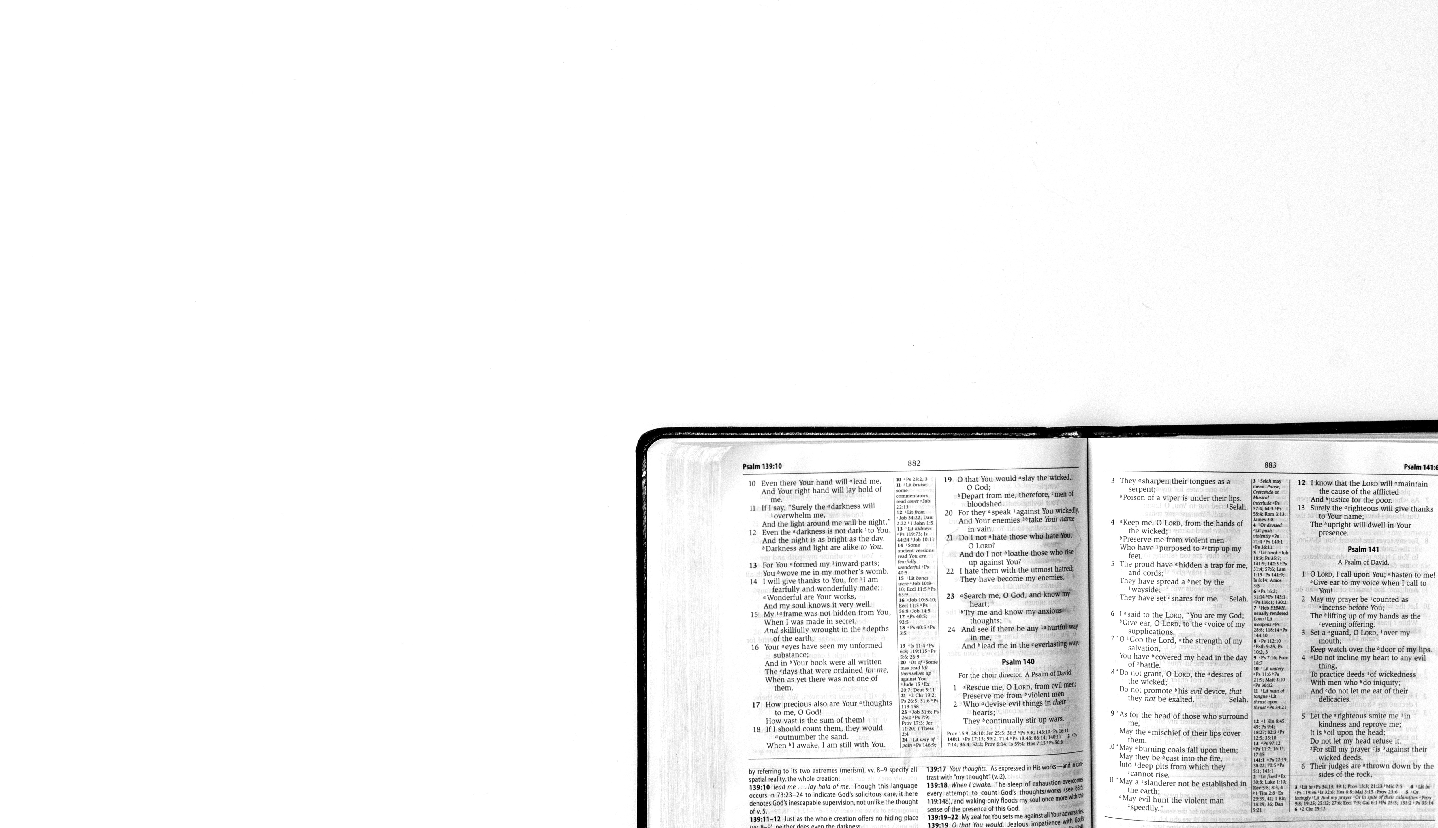
How will a new system help us Make Jesus Known?
To be able to plan for growth,
need sustainable finances
Need to get away from transactional thinking to commit ourselves as one to Gospel vision
Notes:
In all our vision conversations Bishop Stephen has said that he knows we want to stop having to talk about money – but also that the only way to stop needing this conversation is to get to a sustainable position in our financing
Sorting out our finances is both a reflection of our understanding of discipleship, and it clears the way to focus our time and energy on mission and evangelism- our purpose as Christians is to Make Jesus Known

Slide 5

Share review – need for change
Two extensive surveys with high response rate
Rural deans, lay chairs, deanery and parish treasurers Bishops Council
Unanimous agreement that
a new system is needed
Notes:
There’s been an extensive review of the Share scheme, with surveys and discussions- thank you if you participated in these
Its clear that we need to change-
people no longer understood the system,
it came from a time with much higher church attendance,
because it was so complex people felt they no longer trusted the calculations;
it is clear from national research that wealth does not equate with willingness to contribute;
it was felt that it disincentived growth

Slide 6





So what is being proposed as a way forward?
A new vision with clarity of purpose to grow the church #MakingJesusKnown
A new system that faces up to total costs of being Church in the Diocese of Salisbury today
We all need to ask ourselves, what ministry do we want and can we afford?
No longer setting deficit budget as a diocese
Notes:
The old scheme never asked for enough money to pay the costs of being the church- we need to be more honest and realistic
We have been selling assets to balance the books, following the sale of Church House we are running out of assets to sell and now we need to match our expenditure to our giving
Being clear about our costs, and being very open and simple about how Share is calculated will help us to make decisions that show all our costs locally and collectively, and then plan our giving and fundraising to match

Slide 7
What will be different about the new Share model?
Hybrid system which is calculated partly
by costs and partly by membership
60% of the Share request allocated to benefices according to the ministry deployed there (the cost element)
40% of the Share request is allocated according to their Worshipping Community (the membership element)
Mutual support
Not cost of priest but cost of Church
– we are all #TeamSalisbury
40%
60%
Notes:
The review showed wide support for what we are calling a hybrid system- this means that we hold two methods alongside each other- one looks at how we divide our total costs based on where our stipendiary clergy are deployed, and the second looks at how many people are involved in the life of the church
So 60% of the total money that needs to be raised in share is allocated to parishes depending on how many stipendiary clergy they have – this is NOT the cost of clergy, and it is not 60% of the cost of your clergy; it is 60% of the total money we need to raise in Share to pay the costs of being the church
And 40% of the total money that needs to be raised in share is allocated to parishes based on how many people participate in the life of the church. In the Review there was much discussion about how to calculate this number- in the end the agreement was to use a statistic that we already gather every year for the national church- this is called the worshipping community. We will use the national definition of this number.
The 60 and 40 is a good way of sharing our costs because it encourages mutual support which the Review said was something people across the diocese value - it is a way of sharing resources as one body and also reflects the diversity of our local churches in both rural and urban areas.

Slide 8
What assistance will there be?
Partial rebate of fees for weddings and funerals
Financial support to assist those in high deprivation and temporary difficulty
Vacancies of 1+ year will receive a rebate of 75% of 2nd year's parsonage rental income against Share
Four year transition period
Support for fundraising and outreach
Notes:
Weddings and funerals can be an important opportunity for mission so the new scheme gives an incentive to this
About a dozen parishes in the diocese as areas of nationally recognised social deprivation, so we are going to be using the historic funds of the stipend capital account to support ministry there - this was the purpose of that fund originally
Vacancies occur in every parish from time to time; the total number of vacancies means we can reduce the overall budget and therefore the total we ask for in share (at present by about 750k per year)- however, when these vacancies go on beyond the normal year we will be introducing some support
Over four years we will be phasing in changes- we know that those who will be asked for more need time to plan for this - and meanwhile we will have to slow down reducing the ask on others so that the two figures meet in the middle!
Many parishes have already worked with Anna and Harry in our giving team - they can help you with contactless giving and also regular giving through PGS- we know that these make a real difference in encouraging giving to support people and buildings

Slide 9
How will this work in practice?
The total Share request is £12.2m,
so £7.32m (60%) allocated by cost, £4.88m (40%) allocated by membership
There are 159.3 Full Time Equivalent (FTE) priests deployed across the Diocese
The total Worshipping Community (WCom) across the Diocese is 19,416
Cost element
£7.32m/159.3 = £45,951 per priest
Membership element
£4.88m/19,416 = £251 per member
If a parish has one stipendiary priest, a 0.33 House for Duty priest and a
WCom of 125, their share request will be (£45951*1.33) + (£251x125 people)
= £92,490
Notes:
So lets look at the maths: 60% of the total money that needs to be raised in share is allocated to parishes depending on how many stipendiary clergy they have – this is NOT the cost of clergy, and it is not 60% of the cost of your clergy; it is 60% of the total money we need to raise in Share to pay the costs of being the church
And 40% of the total money that needs to be raised in share is allocated to parishes based on how many people participate in the life of the church. While there is work taking place in various parts of our finance , parish Share is the main part of the ‘economy’ of the church.

Slide 10
In a multi-parish benefice of 6 churches with the following Worshipping Communities figures (totalling 125):
A hypothetical example, continued
The Share request would be advised as follows:
Parish A = 12
Parish A = 92,490*12/125 = £8,879
Parish B = 35
Parish B = 92,490*35/125 = £25,897
Parish C = 15
Parish C = 92,490*15/125 = £11,099
Parish D = 45
Parish D = 92,490*45/125 = £33,297
Parish E = 8
Parish E = 92,490*8/125 = £5,919
Parish F = 10
Parish F = 92,490*10/125 = £7,399

Slide 11


