Slide 1
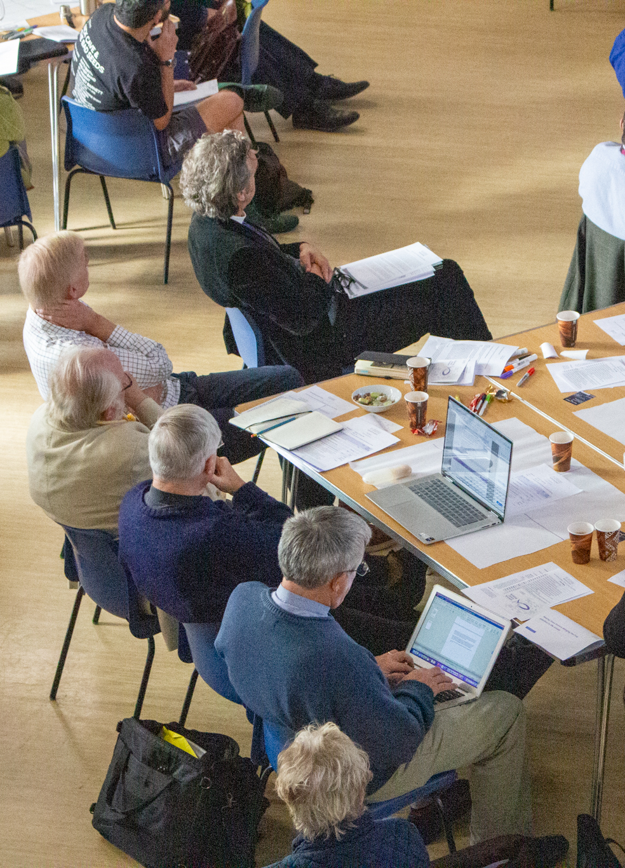
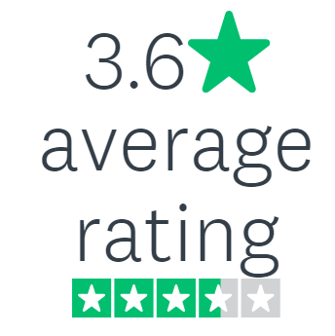
Diocesan Synod
survey feedback
June 2024

Slide 2
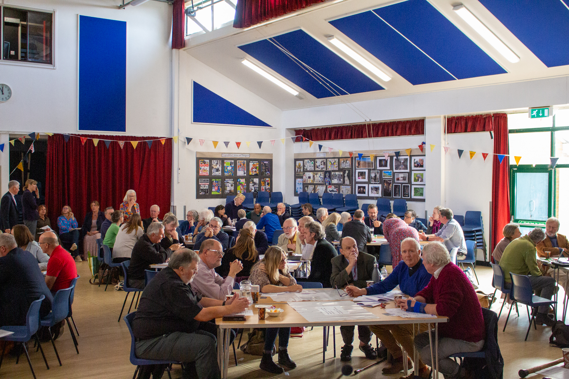
What have you valued this triennium?
Meeting people
Diocesan business
Church of England matters
Representing my community
Topical sessions
Raising awareness & debating parish challenges;
Vision progress

Slide 3
Advice to new members
Prepare (read & reflect on papers)
Engagement with deanery reps
Listen, participate, represent your communities, ask questions
Network at meetings
Feedback to deaneries; cascade of information

Slide 4
Synod meeting practicalities
12 October: In person, Saturday (usually 10:00 – 15:30)
February: Virtual, mid-week evening (usually 17:30 – 20:00)
June: In person, mid-week evening ; DBF AGM

Slide 5
Summary
A strong desire to be an effective and impactful body and for members to make meaningful contributions (what does good look like?)
More discussion, debate, networking and participation
Focus on topics that will make a difference / matter, i.e. parish challenges and vision progress
A range of ways to engage, feedback and raise questions
Blend of in-person & virtual meetings at ‘central’ locations
Induction for all members
Improve dissemination of information
Strengthen the link and effectiveness of Diocesan / Deanery synods
The need and desire to attract a younger and more diverse membership that represents the communities we serve

Slide 6
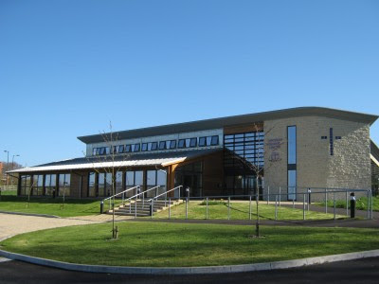
Contact us
parishsupport@salisbury.anglican.org
Phone: 01722 411922
Joanne Sandall-Ball (ext 325)
Miriam Longfoot (ext 342)
Elizabeth Harvey (ext 315)
Name.surname@salisbury.anglican.org

