Slide 1
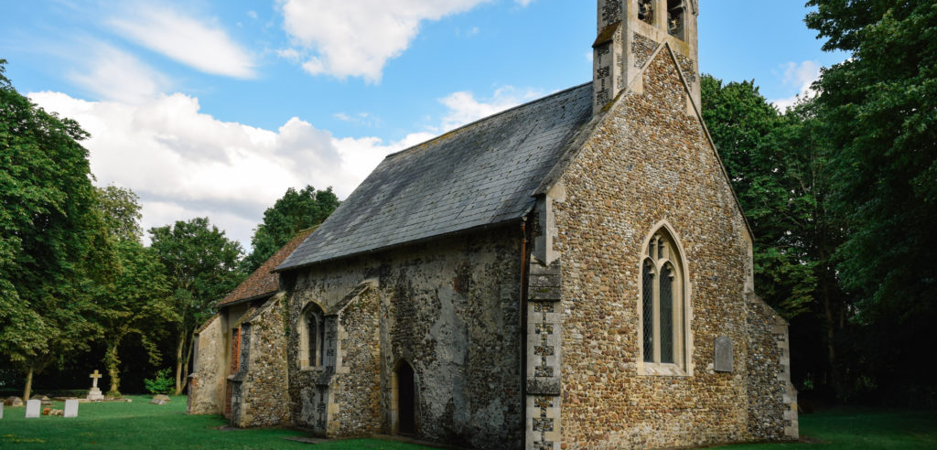

The Faculty Jurisdiction Rules, The DAC and the Church Buildings Team

Slide 2
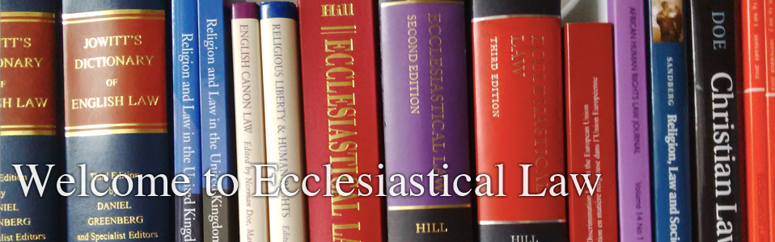
What are the Faculty Jurisdiction Rules?
Anglican churches, under Ecclesiastical Exemption, are exempt from secular listed building consent so long as an equivalent system is in place. This system is known as Faculty Jurisdiction.
The Faculty Jurisdiction Rules (FJR’s) cover all that is within the curtilage of the church. That being the churchyard, the church and the fixtures and fittings within.
Each Faculty is determined by the Chancellor of the Diocese, with the advice of the Diocesan Advisory Committee (DAC) and is a legally binding document.
There are 3 basic types of permission within the FJR’s.
  Full Faculty (Determined by the Chancellor)
  List B (Delegated to the relevant Archdeacon)
  List A (Permission automatically given)
Fact:
Faculty permission predates any secular planning controls and can be traced to the mediaeval era.
Ecclesiastical Exemption makes allowances that the secular system does not based on the fact the church is a place of worship.

Slide 3
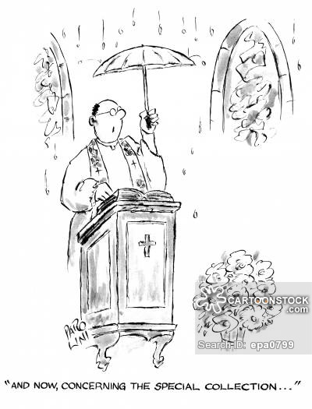
What does that mean for the church?
The maintenance of the church lies primarily with the PCC but depending on individual circumstances in is not uncommon for the incumbent to make applications.
It is important to maintain the building and get the appropriate permissions for adaptions as it is a prosecutable offence to neglect a listed building.
If you are considering carry out works of any kind, it is highly likely that you are going to need to apply for the relevant permission.
Works that can be carried out under List A and B can be found in schedule 1 of the FJR’s. This is available on our website but if in doubt contact the Church Buildings Team for advice.
Gaining the relevant permissions can be a time-consuming process so don’t put off having works done.
All applications are processed online using the Online Faculty System. In order to start or process applications individuals need to be registered first.
Fact:
Anyone can make an application on the Online Faculty System so long as they have the permission of the PCC.

Slide 4
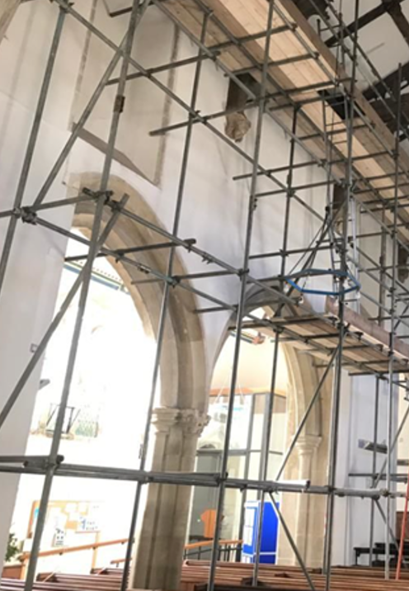
What does the Salisbury DAC do?
Key Role:
The DAC is an advisory body on matters affecting places of worship in the diocese. The committee is made up relevant subject matter experts ranging from archaeology, bells, organs and architecture.
What does the DAC advise on?
The grant of Faculties and list B applications
The architecture, archaeology, art or history of a place of worship
The use, care, planning, design or closure of a place of worship
The use or care of contents of a place of worship, or
The use or care of a churchyard or burial ground
Who does the DAC advise?
The bishop of the diocese
The chancellor of the diocese
The archdeacons – 4 in total
The PCC for each parish in the diocese – 500 +
The mission and pastoral committee of the diocese
A person engaged in the planning, design or building of a new place of worship in the diocese
Such other person as the committee considers appropriate
Fact:
The DAC is not a decision-making body. All Faculty’s are determined by the Chancellor.
The DAC cannot design something for you, but they can give you good advice throughout an application.

Slide 5
Who’s who in the Faculty process
Practical review of application
Legal review of application
DAC committee
Amenity Societies
Archdeacons
Chancellor of the Diocese
Organisations with a specialist interest who must be consulted during faculty applications for various works, these include:
Victorian Society
Historic England
Society for the Protection of Ancient Buildings (SPAB)
Georgian Group
20th Century Society
Church Buildings Council
Chancellor delegates power to grant List B permission
Archdeacon of Sarum –
The Venerable Alan Jeans MBE
Archdeacon of Sherborne –
The Venerable Penny Sayer
Archdeacon of Wilts –
The Venerable Sue Groom
Archdeacon of Dorset –
The Venerable Antony MacRow-Wood
A group of volunteers with specialisms relating
to church buildings who advise the Chancellor on faculty applications and who are appointed by Bishop’s Council
Chair – The Revd Richard Curtis
The Judge of the consistory court of the dioceses. The Chancellor is the sole decision maker for all faculty matters.
Mrs Ruth Arlow
Contact: The Diocesan Registry
Diocesan Registry
The legal office of the Diocese, employed at the law firm Batt Broadbent. The team ensure that the application forms are accurate and due legal process has been followed.
Registrar - Sue de Candole
Deputy Registrar – Rachel Wilson
Registry Clerk – Alix Austen
Registry Clerk – Sarah Hart
Registry Clerk – Anita Jeans
Church Buildings Team
Applicant/Petitioner
The Secretariat for the DAC Committee.
The team at Church House are the first point of contact for all
faculty and List B matters.
Mr Daniel Crooke – DAC Secretary
Mrs Alex Weedon –Church Building Officer
Lucy Scott – Assistant Church Building Officer
A representative of a PCC or private individual
wishing to apply (petition) for permission to carry out works within the church or churchyard

Slide 6

Who are the Church Buildings Team?
The Church Buildings Team is the first port of call for all enquiries regarding works to churches.
The team manages the Faculty process together with the quinquennial inspection scheme, site visits, the DAC committee and so much more.
We are here to help PCC’s, incumbents and applicants navigate the Faculty process. This includes advice and troubleshooting on anything regarding the Online Faculty System.
The team are here to help advise applicants on the content and quality required for an application to be successful and can help collate this.
The Church Buildings Team can also determine what permission certain works require, so if in doubt please get in touch.

Slide 7

What the Church Buildings Team do and how we communicate?
Applicant, Petitioner, Incumbent
Answer queries
Give direction on the use of the Online Faculty System
Give advice on specific information required for applications
Ensure the correct application is made
Direct to the correct advice and guidance
Validate applications and ensure complete
DAC Committee
Chancellor & Registry
DAC Committee meetings
Give advice and guidance to parishes
Consultation advice on applications
Site visits to give pre-application advice
Record minutes of DAC meetings and action as appropriate.
Administer directions from Chancellor
Consult DAC regarding interim faculties
Record Faculties granted by Registry
Process provisos for granted faculties
Church Buildings Team
Provide that little bit of magic that helps the system go round
Amenity Societies
Archdeacons
Decided and ensure the correct societies are consulted
Record responses on the Online Faculty System
Invite to DAC site visits and committee meetings
Liaise between amenity societies and applicants
Administer the List B application process (AD's permission)
Liaise with PCCs/parishioners on matters of liturgy
Ensure AD availability for site visits
DAC committee meetings
DIRECT
INDIRECT
Emails
Telephone
Drop in sessions
Presentations to PCC's
Organise and record site visits
Surveys & questionnaires
Virtual meetings
DAC Guidance Documents
Website
Parish Newsletters
Administering Online Faculty System
Keep a database of applications and communication
Administer database of quinquennial inspections
Input Notification of Advice into OFS.
Keep policies up to date to ensure the efficient working of the DAC
Maintain list of Architects and DAC members
Administer the Care of Churches Measure and Faculty Jurisdiction Rules 2015 to ensure churches are maintained and remain places of worship and Christian Mission

Slide 8

Useful Links and Contacts
Church Buildings Team: DAC@salisbury.Anglican.org
Registry: Registry@salisbury.Anglican.org
Parish Support: Parishsupport@salisbury.Anglican.org
Church Buildings Team Website: https://www.salisbury.anglican.org/parish-support/care-of-church-buildings-and-churchyards/
Diocesan QI scheme: https://www.salisbury.anglican.org/parishes/dac/quinquennial-inspections
Relevant legislation (including schedule 1 List and B): https://www.salisbury.anglican.org/parish-support/care-of-church-buildings-and-churchyards/faculties/
Churchcare Website: https://www.churchofengland.org/resources/churchcare/church-buildings-council
Parish Buying: https://www.parishbuying.org.uk/

